Slide 1
Excurj
Team members:
Blair Calderwood
Seif Elmughrabi
Martin Grant
Ihsan Riaz
The Traveller Social Network.

Slide 2
The Idea
We all love to travel, we love discovering new places and learning about new cultures. But sometimes we’re tired of being tourists and just be able to take pictures of famous monuments.
What we really want is to socialize and interact with the local population and have them show us around to interesting places to see and fun things to do.
Excurj is website that offers immediate interaction between locals and travellers. On one hand travelers receive unique local experiences at their destination, on the other hand locals get to make friendships with people from all over the world.

Slide 3
Value
Offers immediate interaction via chat and email notifications (when offline).
Ability to leave a rating and a comment about the experience.

Slide 4
The Users

Slide 5
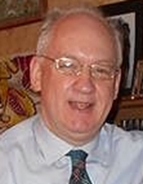
Persona 1
Name: John.
Profession: Minister at the local church
in East Kilbride, Scotland.
Age: 55 years old
Education: holds a degree in History from Saint Andrews University.
John has visited many countries and enjoys meeting people from all over the world to learn about their culture. He loves showing visitors around his town and invites them to his house for dinner to share stories from his travels.
He’s currently using an organization that helps him meet international students living in Glasgow area and would love to be able to meet more people who are looking to learn about Scotland and Scottish culture.

Slide 6
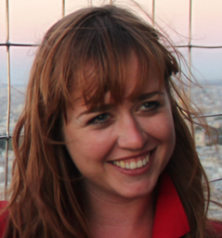
Persona 2
Name: Ani.
Profession: Student.
Age: 21 years old
Education: Studying BSc Computer Science in
New York City.
Ani is traveling across Scotland for her spring break. However, she doesn’t like just sightseeing, she prefers sight-doing instead. She likes to interact and socialize with the local population and attend local events.
She’s currently using social media and friends and family connections to look for things to do, and would love it if there’s an easy way to meet locals while traveling, to experience her destination from a local perspective as opposed to the typical tourist experiences.

Slide 7
Main Requirements of the Application
Users can search through the categories of different countries and cities and find people to meet.
Users can register their accounts.
Users can chat to get to know each other and plan the trip.
If the user is offline the message is sent via email.
Travelers/locals get to leave comments and a 5 – star rating about their experience to encourage others to meet the same person.
The home page will provide: Search field to search for a city.
  Super stars section: the top 5 users with the highest ratings.
  Popular cities: cities with the highest number of profiles associated with it.

Slide 8
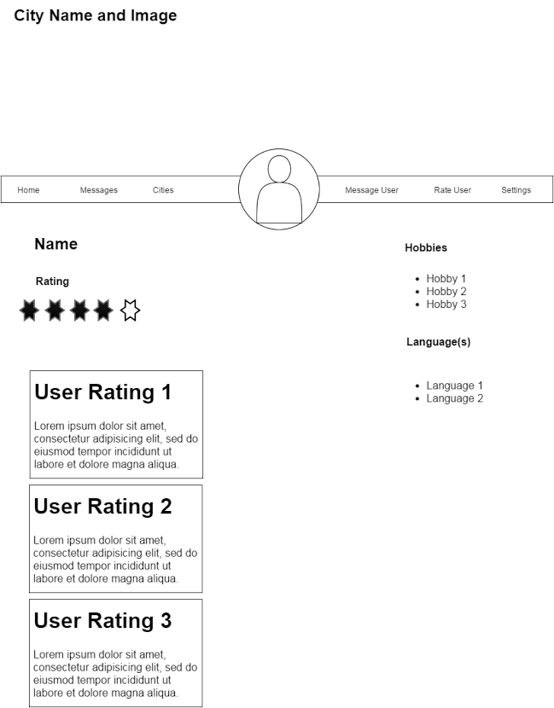
Wireframe

Slide 9
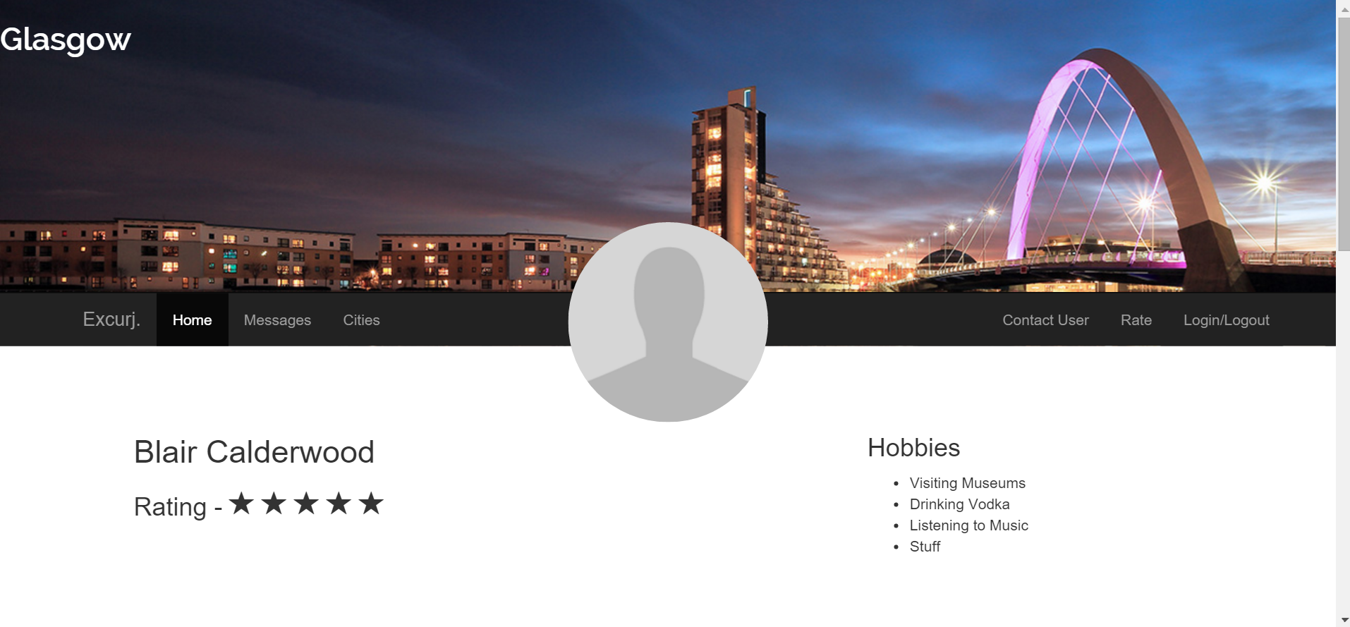
Screen Shot 1

Slide 10
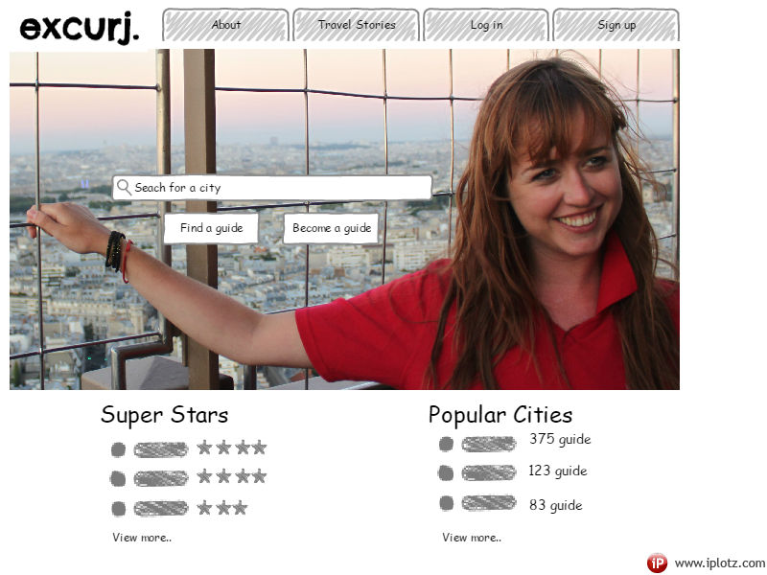
Screen Shot 2

Slide 11
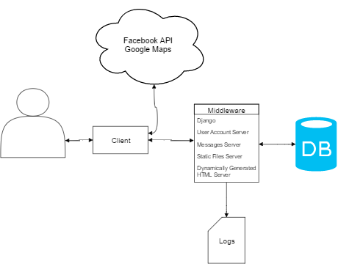
System Architecture

Slide 12
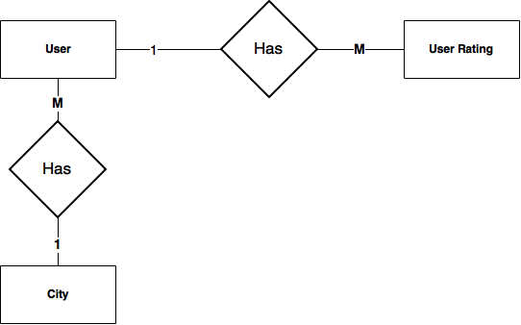
ER-Diagram

Slide 13
User
Field | Type
Username | Char
Profile Picture | Image
First name | Char
Second name | Char
Email | Char
City | Char
Hobbies | List<Char>
Languages | List<Char>
Rating | Integer
User Ratings | List<User Rating>

Slide 14
City
Field | Type
Name | Char
Description | Char
Tour Guides | List<Users>
Rating | Integer
User Rating
Field | Type
Author | User
Description | User
Rating | Integer

